Slide 1
Dependency

Slide 2
Dependency injection
Take all needed dependencies for this class
Check if dependency exist (where to find)
If found, check if dependency already have an instance; If yes – return instance, if not – create one
Consumer
Dependency
Provider
Injection token
Injector

Slide 3
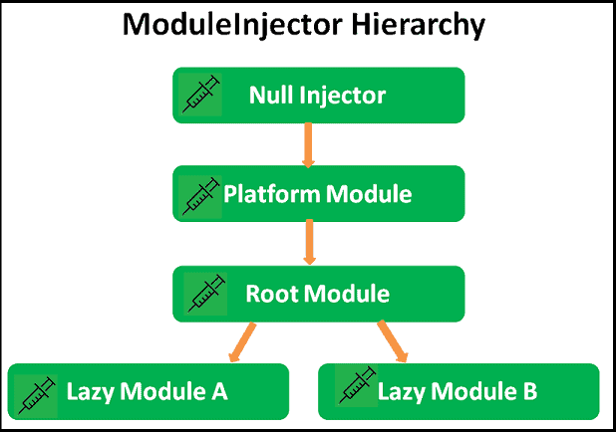
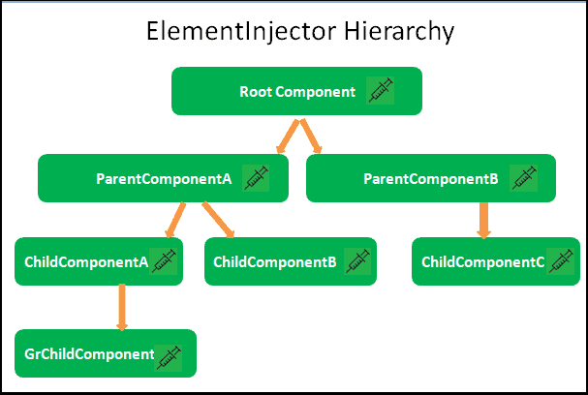
Dependency Injection
& Resolution

Slide 4
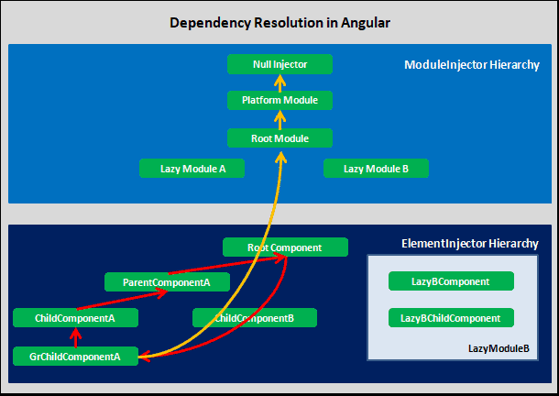
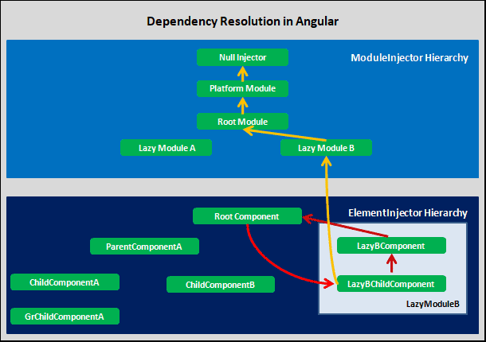
Dependency Injection
& Resolution

Slide 5
Tree shaking

Slide 6

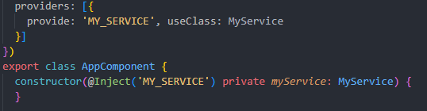
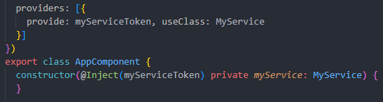
The Types of Tokens
Type token
String token
Injection token

Slide 7
The Types of Provider
useClass
useValue
useFactory
useExisting

Slide 8
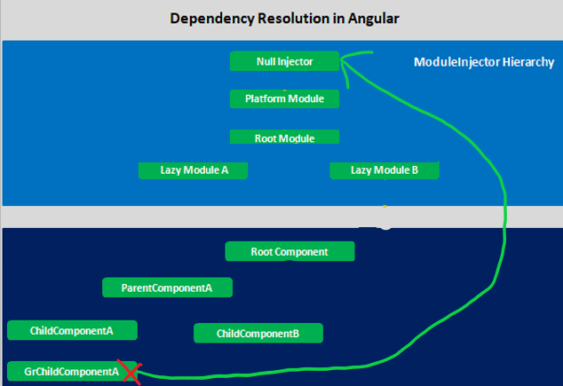
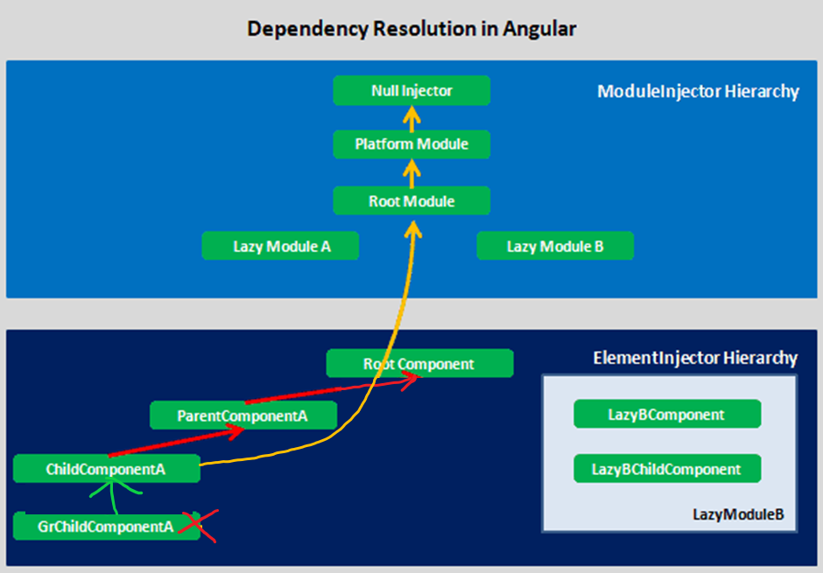
Dependency resolve types
@Self
@SkipSelf

Slide 9
Dependency resolve types
@Optional
@Host

